Slide 1


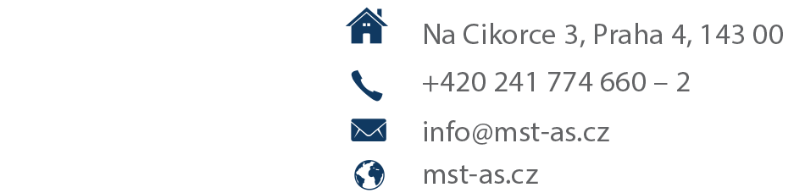
| SDVN | Live Production | Data Analytics | Asset Management & Playout | Media Networking&Processing | Multiviewers | Audio production |
| Audio production |

Slide 2
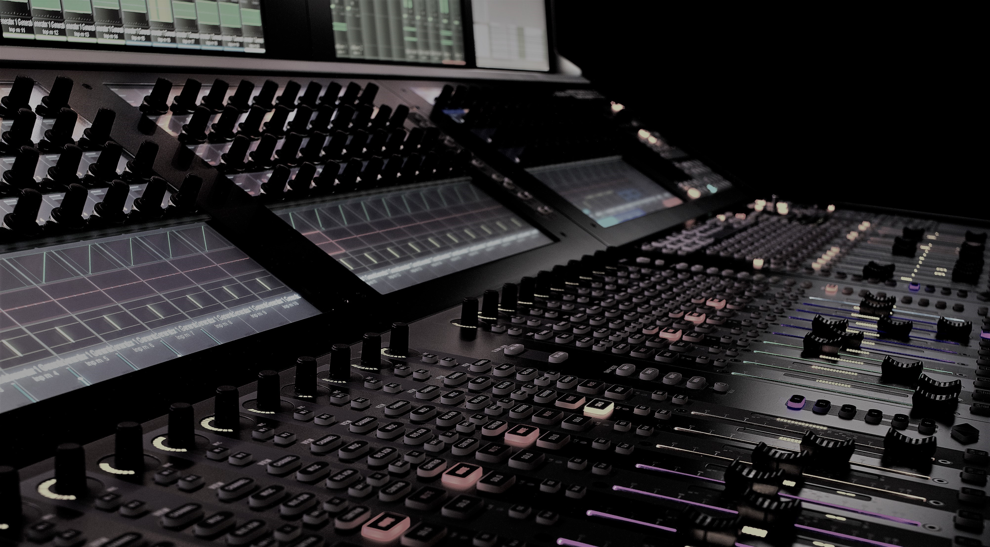

Legendary Audio

Slide 3
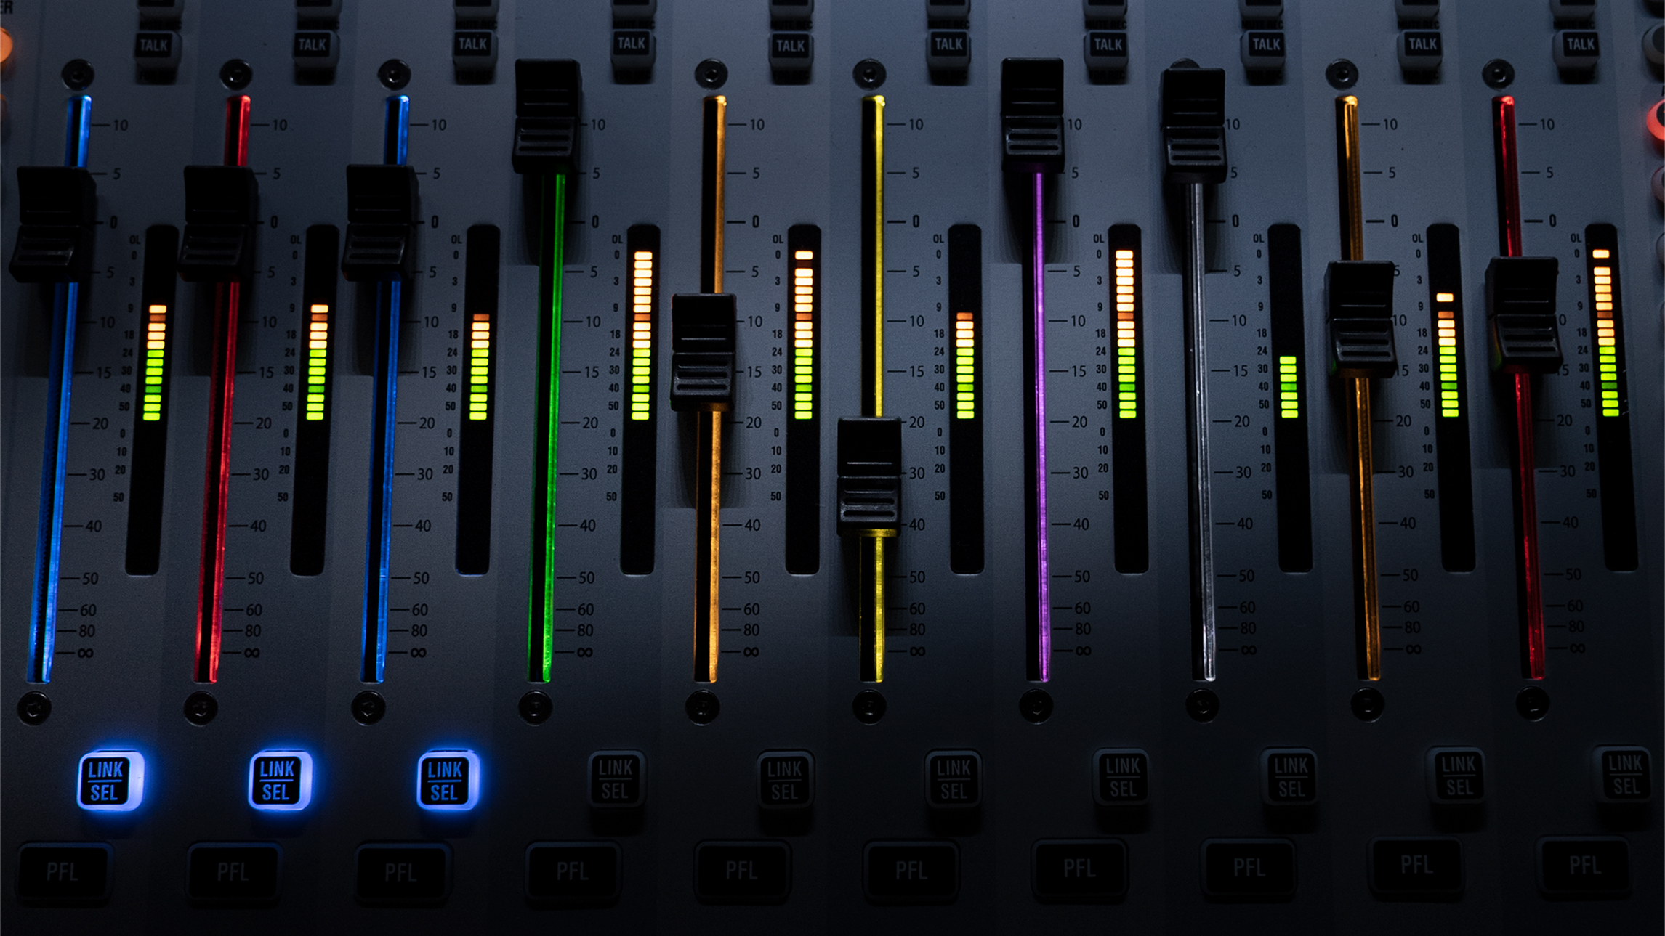
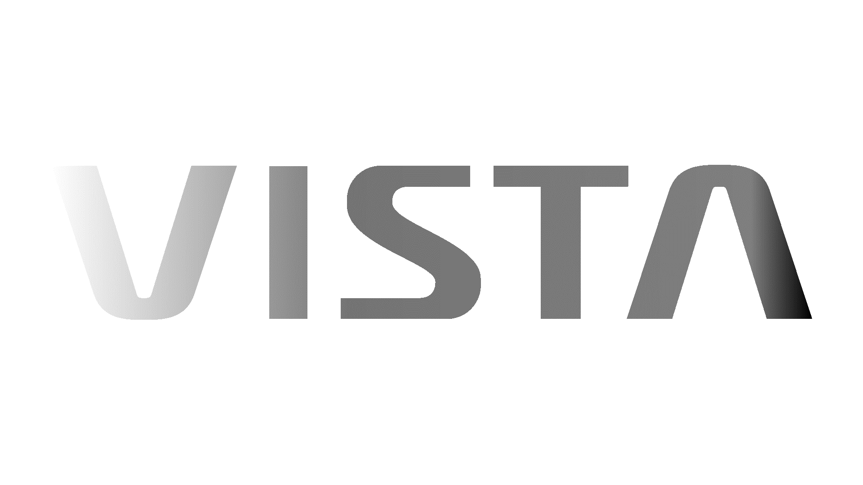
Lineup
Notes:
The Vista Line is our series of consoles that all share similar features in the control surface.

Slide 4
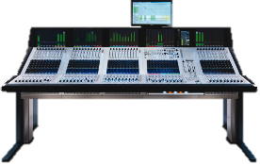
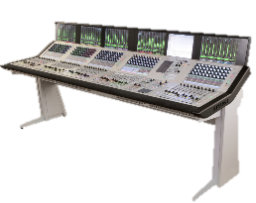
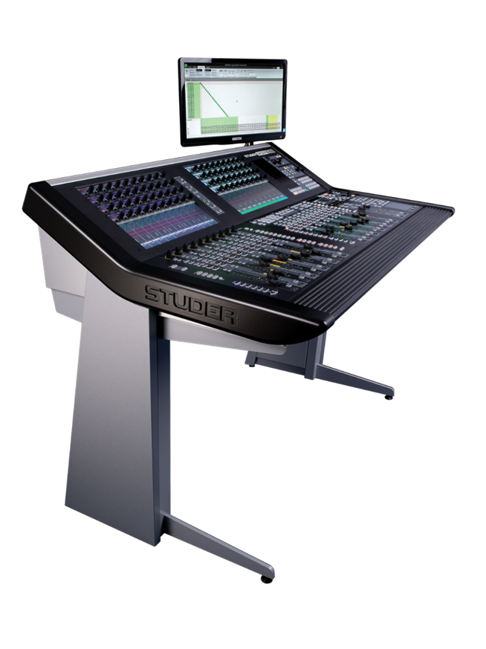

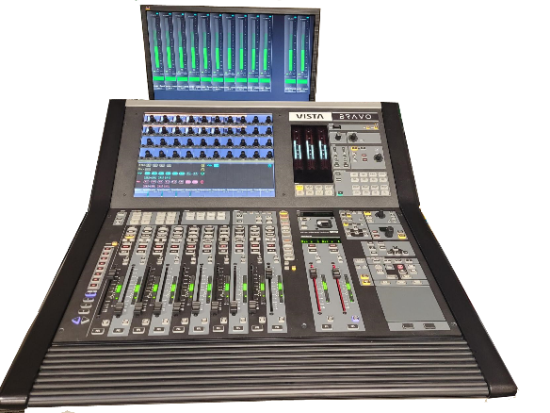







VISTA Production Mixing Consoles
Flexible & powerful
Separate/configurable
processing and I/O
All-in-One Built in Processing & Expandable I/O
Functionality & Complexity →

Slide 5

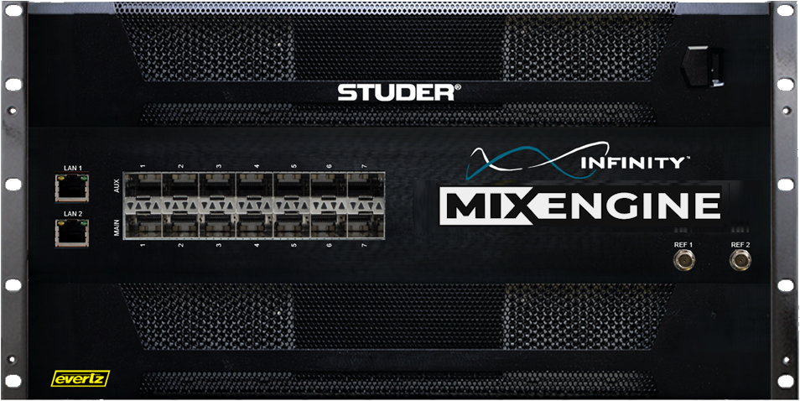

Studer Infinity
New fully redundant Mix Engine with “Active Transfer” technology for seamless core failover
ST2022-7 compliant for network redundancy
No single point of failure
Scalable porting – Configurable, SFP based network connectivity
550 & 1100 Mono EQuiv channel & bus models
More than 5000 I/O channels
1, 2, 4, 8 & 16 flows per stream
Configurable DSP
Studer’s legendary sound
Q4 -2025
Compliant
ST2110-30 Ports
Console Control LANs

Slide 6
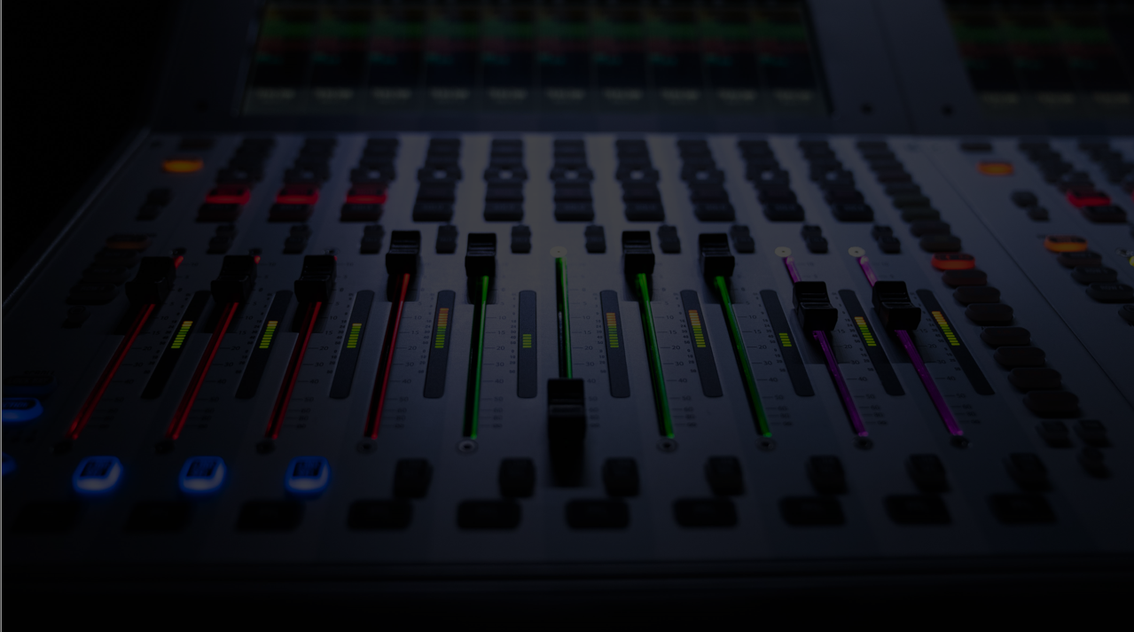
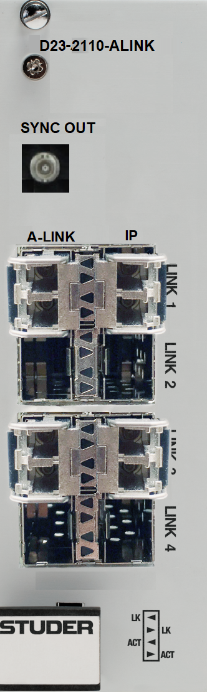
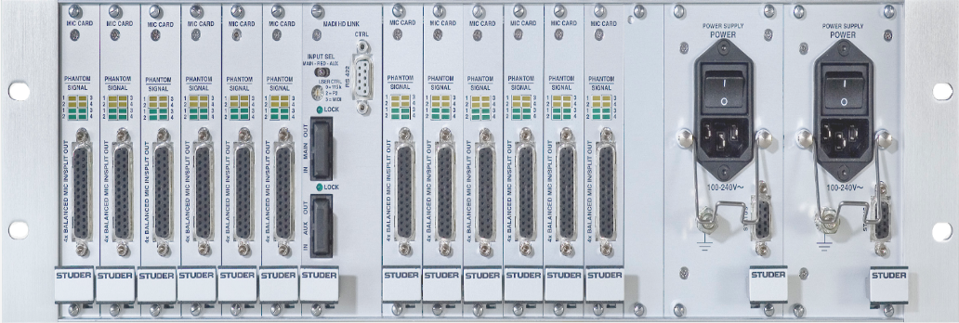
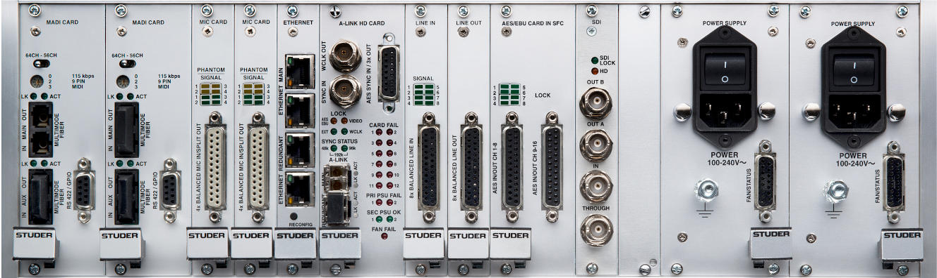


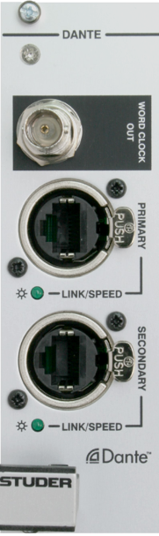

D23m-2110-ALINK
I/O SOLUTIONS
IP translation for D23m I/O Frames
ST2110-30
ST2022-7
NMOS Compliant IS04/05
1, 2, 4, 8 and 16 channels per flow
Retrofit into any D23m
Compliant

Slide 7
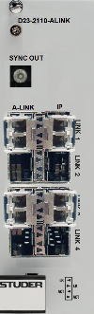
D23m-2110-ALINK
I/O SOLUTIONS
IP translation for D23m I/O Frames
ST2110-30
ST2022-7
NMOS Compliant IS04/05
1, 2, 4, 8 and 16 channels per flow
Retrofit into any D23m
Compliant

Slide 8
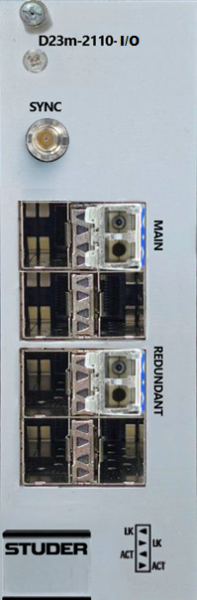
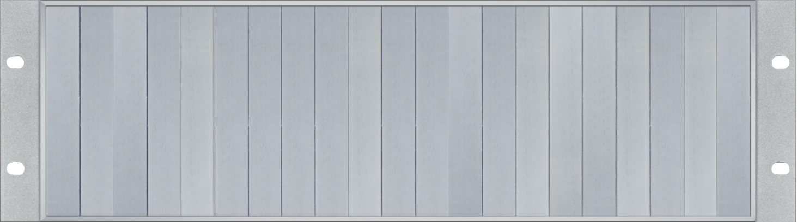
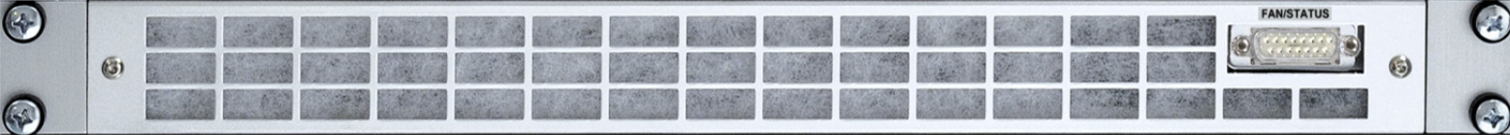
I/O SOLUTIONS
D23m-2110-IO : Audio over IP card
Allows any A-Link based D23m to be ST2110-30 capable
ST2022-7 compliant
256 I/O channels per card
Max 3 cards per D23 frame – Total 768 channels
SFP-based 2110 bi-directional interface
Multi mode or Single Mode
Can be mixed with other D23 cards
D23m I/O frames only (new or existing)
Double width D23m card
Compliant
Notes:
This card converts the D23m’s internal A-Link controller card signal to 2110-30 to allow the access and use of any of the connected I/O within the frame on the 2110 network.

Slide 9
I/O SOLUTIONS
D23m-2110-IO : Audio over IP card
Allows any A-Link based D23m to be ST2110-30 capable
ST2022-7 compliant
256 I/O channels per card
Max 3 cards per D23 frame – Total 768 channels
SFP-based 2110 bi-directional interface
Multi mode or Single Mode
Can be mixed with other D23 cards
D23m I/O frames only (new or existing)
Double width D23m card
Compliant
Notes:
This card adds an A-Link to 2110 conversion gateway directly to the D23m frame for direct connection to the core IP switch fabric.

Slide 10
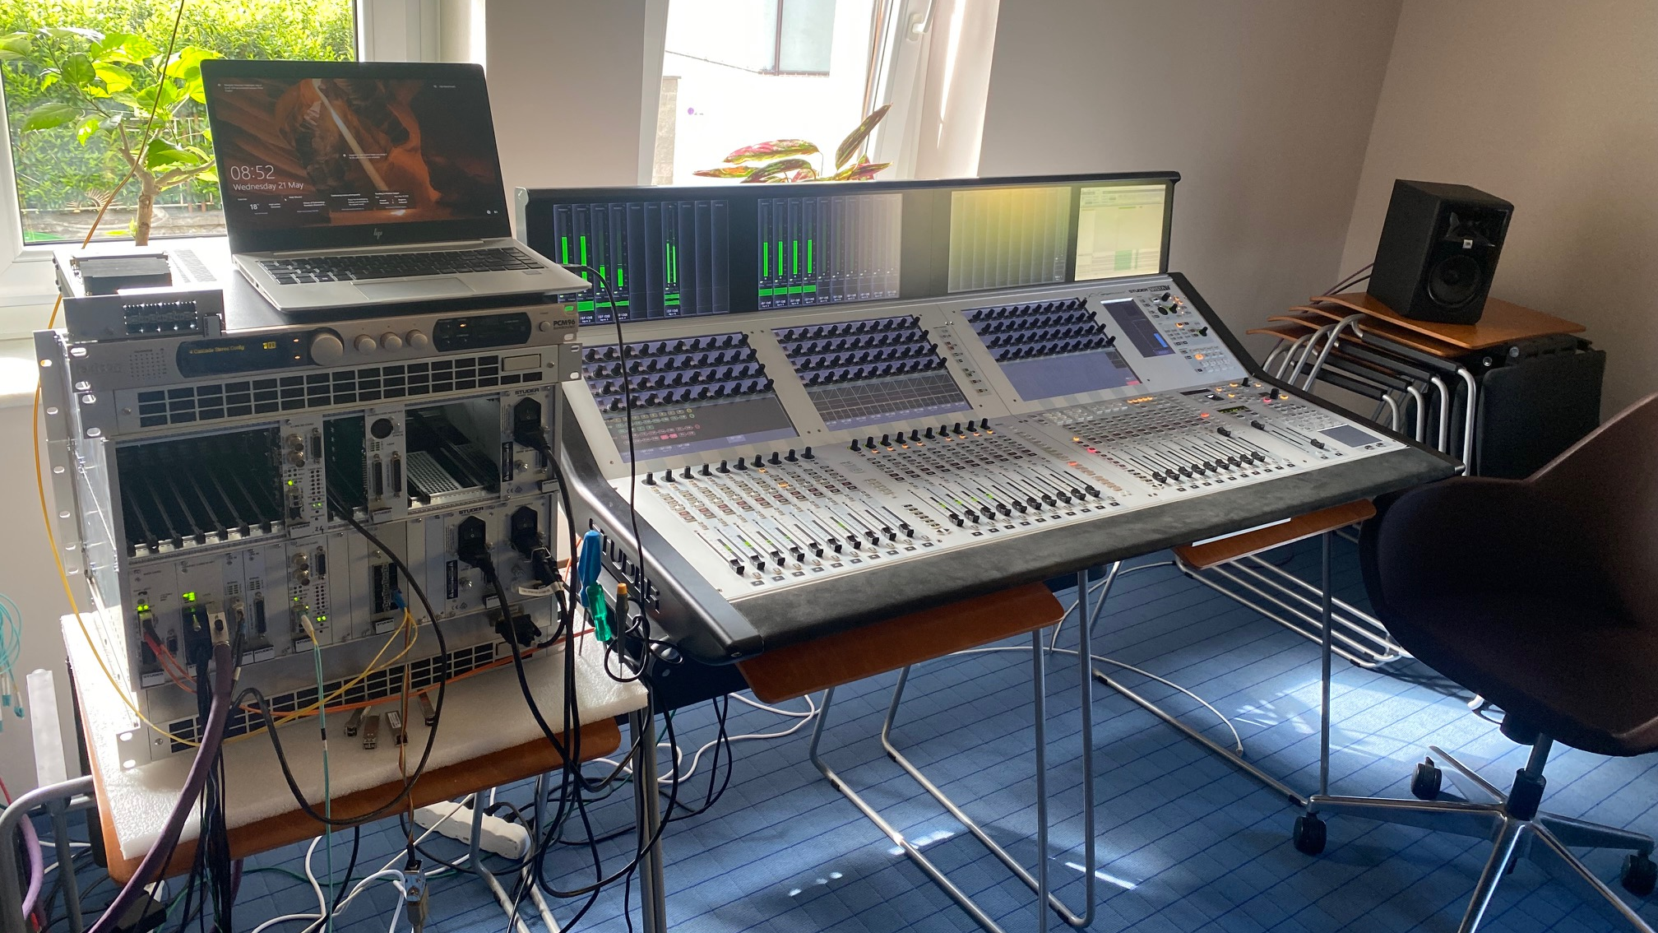

Slide 11
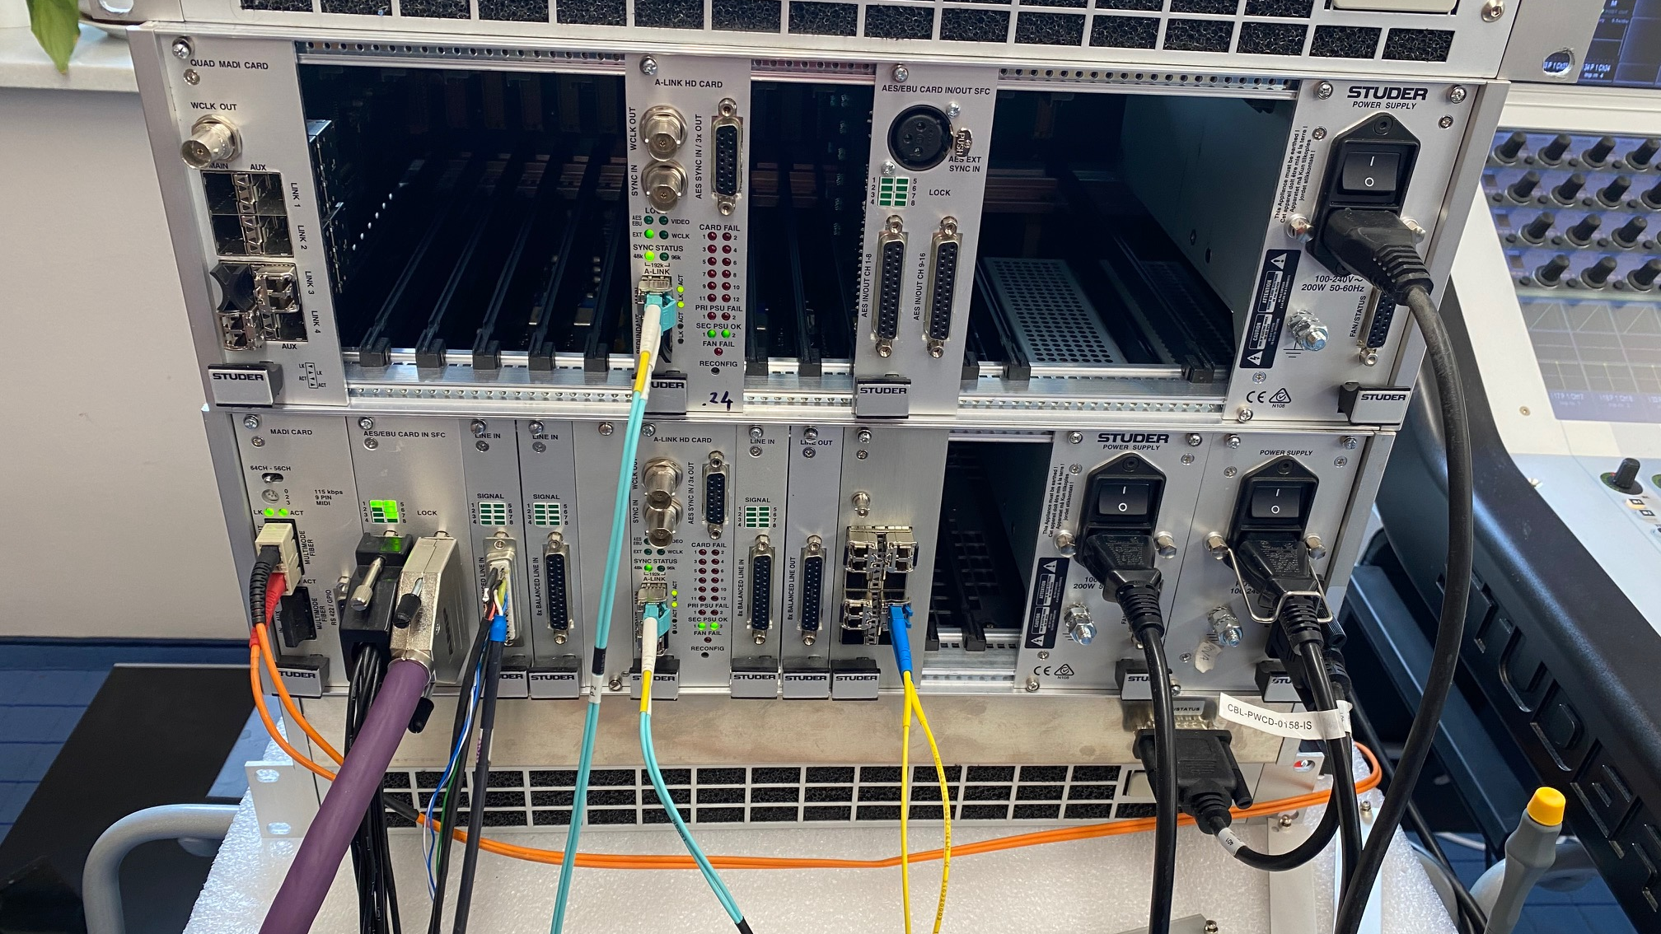

Slide 12
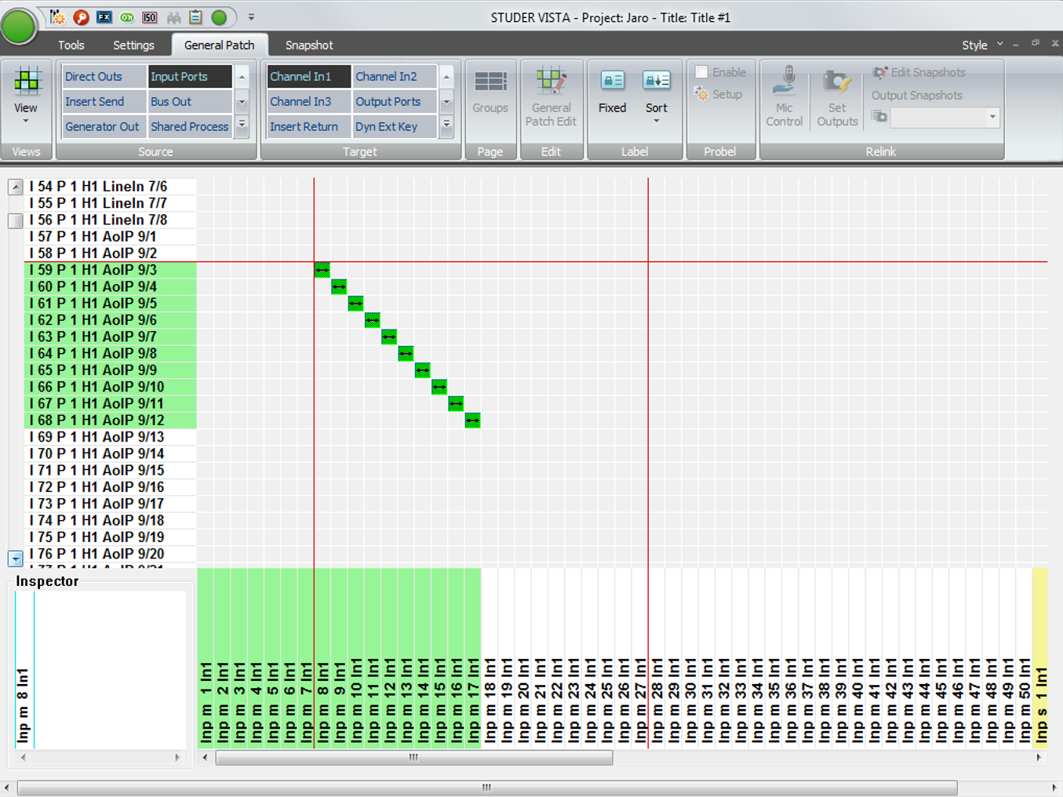
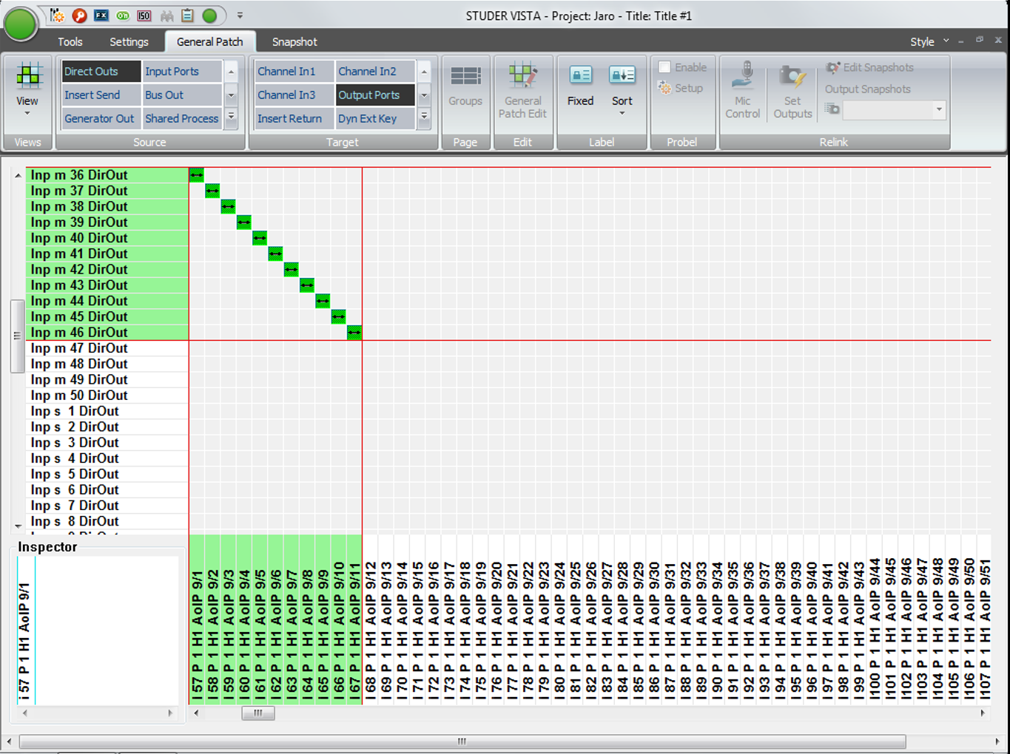
ST2110-30 Inputs & Outputs in Vista core matrix

Slide 13
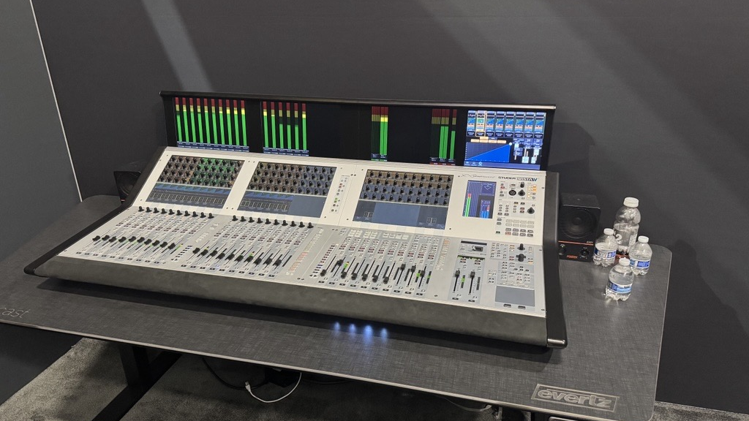

Slide 14
I/O SOLUTIONS
Mini-Audio-Gateways
Small Form Factor, Cost Effective ST2110 mini gateway modules
Supports ST2022-7 network redundancy
NMOS IS-04 registration and IS-05 connection management compliant
Compliments larger D23m I/O system
Desktop “throw-down” modules
Module Options :
Dante – 64 channel I/O
AES – 6 channel I/O
Line In – 8 channel
Line Out – 8 channel
Compliant
Notes:
This card adds an A-Link to 2110 conversion gateway directly to the D23m frame for direct connection to the core IP switch fabric.

Slide 15

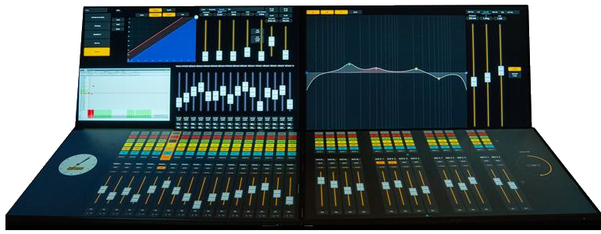
Your console, your way
Notes:
The Vista-In-Vue system uses a Vue-Edge-Pro loaded with a thin layer of Magnum specifically for the Studer system. Wave Boards can also be added for tactile control.

Slide 16
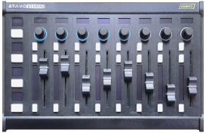
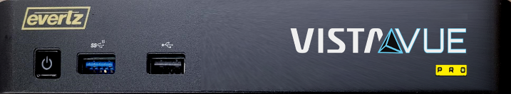
Your console, your way
VISTA-IN-VUE allows you to :
Create your own audio mixing console or workstation,
Augment any Vista console, new or existing. 2000+ bi-directional control points
Set up multiple local and remote production stations.
Provides flexibility and control required in today’s modern live production environments
Harnesses Evertz VUE intelligent UI
Touch screen or multiple motorized fader modules
VISTA-IN-VUE and VISTA-IN-VUE-PRO desktop units include Magnum OS device layer
VISTA-CLIENT desktop unit provides a “headless” Vista system & couples with Studer Infinity Core and I/O system
Notes:
The Vista-In-Vue system uses a Vue-Edge-Pro loaded with a thin layer of Magnum specifically for the Studer system. Wave Boards can also be added for tactile control.

Slide 17
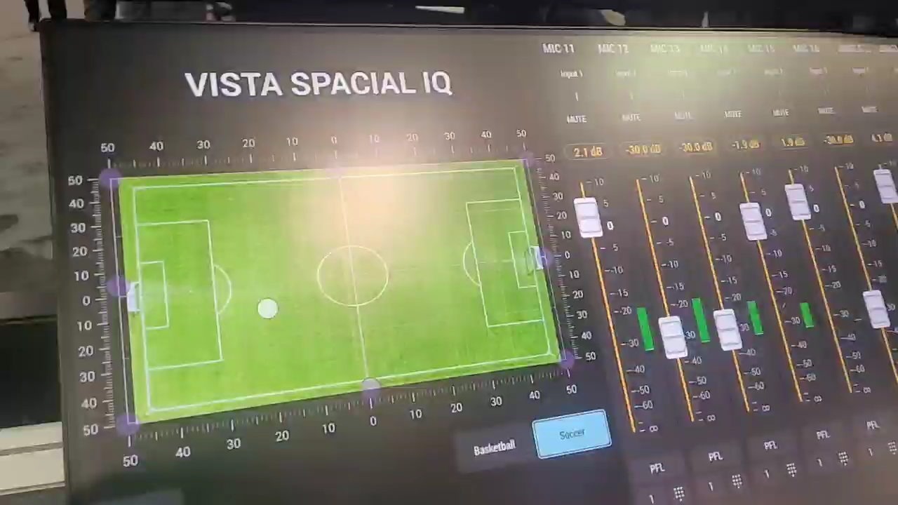
Vista Spatial IQ
Simple point, touch and move operation
Different overlays can be used
Football/Soccer/Rugby field
Hockey rink
Basket Ball arena
Race course/Race track
Sports field/athletics track
And more….
Strategically placed microphones change levels automatically
Auto mode available to automatically follow the contestant action/ball/puck
Notes:
The Vista-In-Vue system uses a Vue-Edge-Pro loaded with a thin layer of Magnum specifically for the Studer system. Wave Boards can also be added for tactile control.

Slide 18
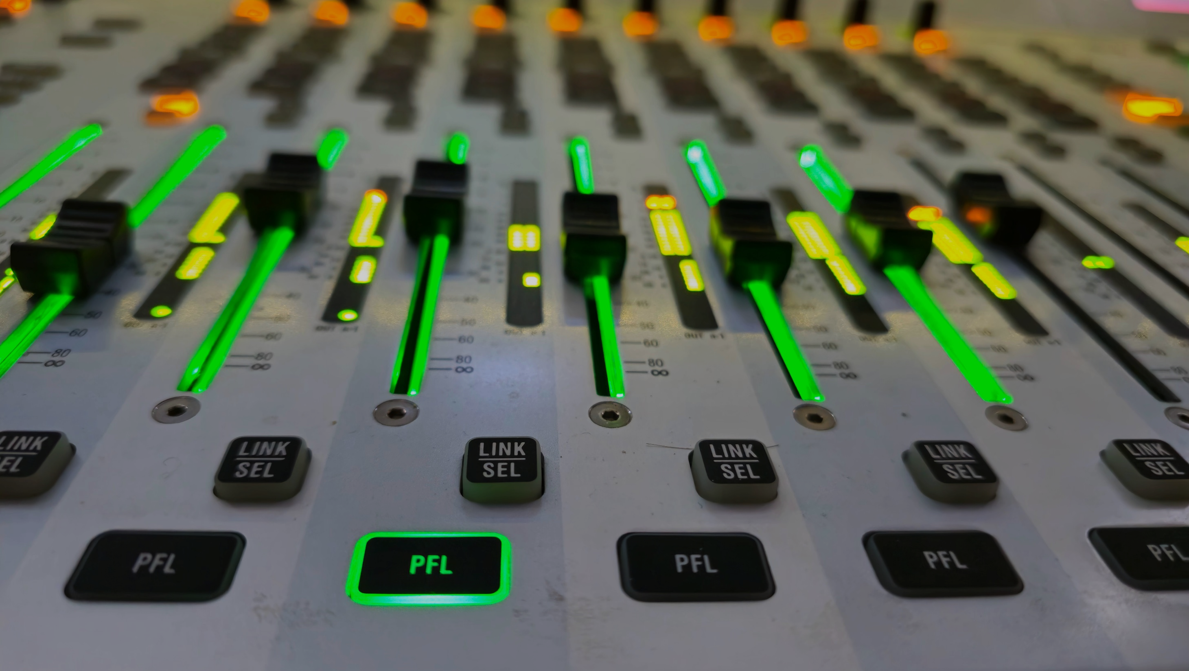
VIDEO
PFL
Notes:
Pre-Fader Listening (PFL) lets the operator interrogate the incoming audio signal as it sounds before it’s mixed. This happens non-destructively and gives the operator the ability to locate potential issues and their origin.

Slide 19
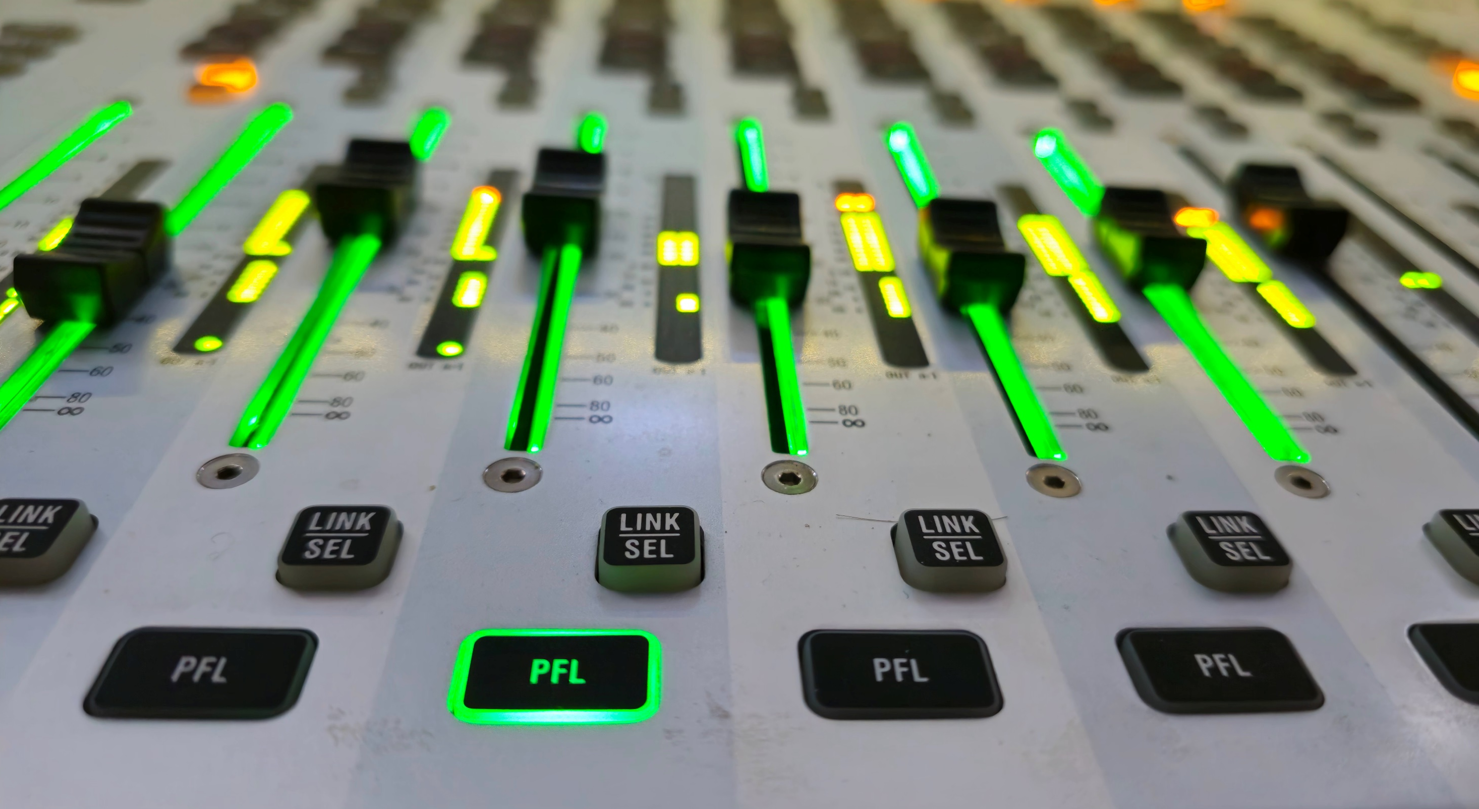
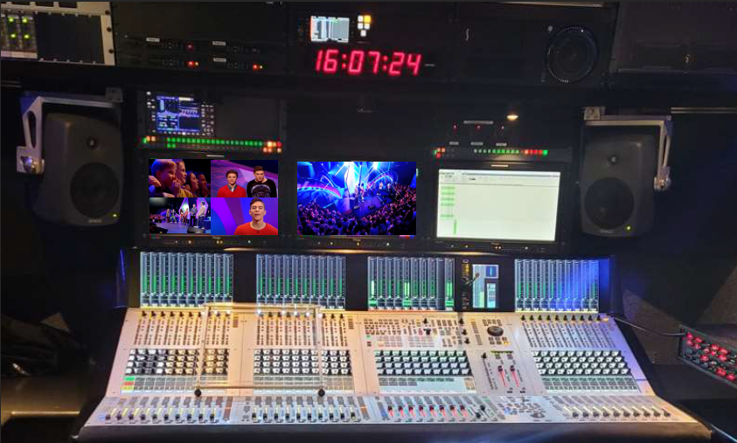
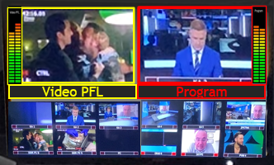


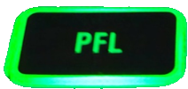

What is
VIDEO
PFL
Simple to operate Video Follows Audio
Press the Studer Vista’s PFL button to
instantly call the video source associated
with that channel’s audio to an A1’s
dedicated VPFL monitor
Unified control between Magnum OS and
the Vista application
Combined non-destructive Audio
and Video monitoring
Single monitor or Multiviewer options available
Notes:
VPFL: A1’s love this! A user-selected audio to video source. Any video source can be connected to any audio source on the console as chosen by the Operator.

Slide 20
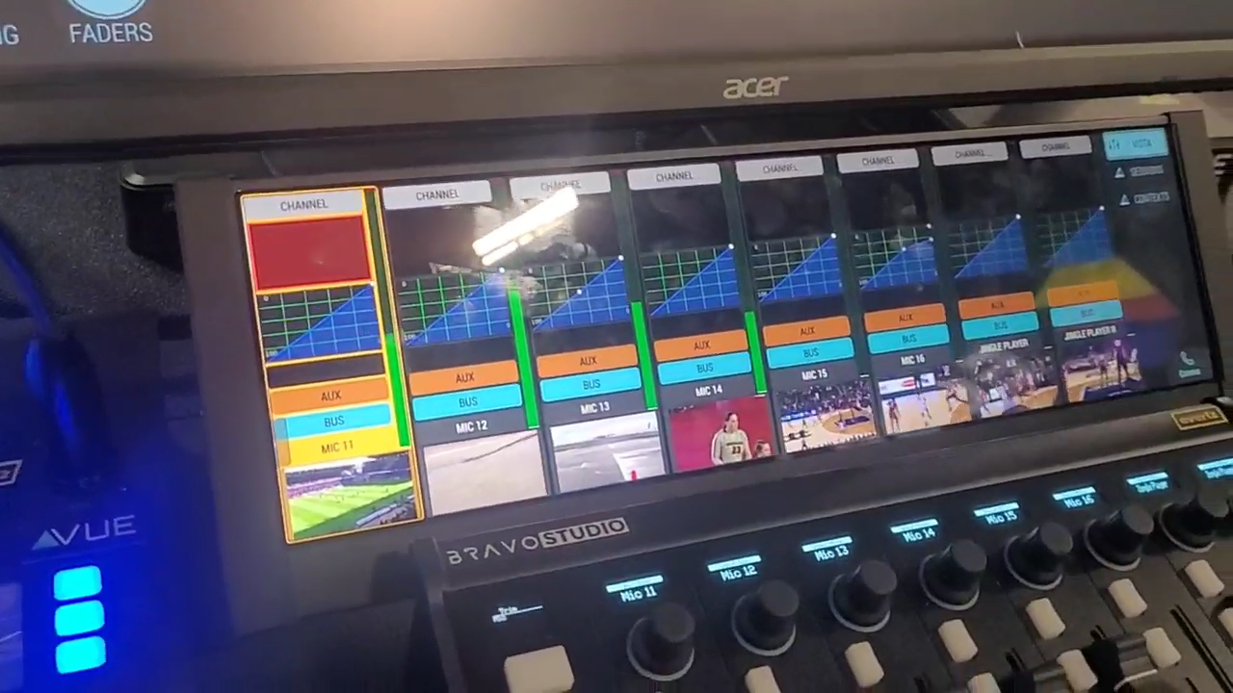
Video PFL
Enhancement
Notes:
The Vista-In-Vue system uses a Vue-Edge-Pro loaded with a thin layer of Magnum specifically for the Studer system. Wave Boards can also be added for tactile control.

